Slide 1

"HANDWRITTEN DIGIT CLASSIFICATION"
USING CONVOLUTIONA NEURAL NETWORK
PRESENTED BY KETAN KHANDELWAL

Slide 2


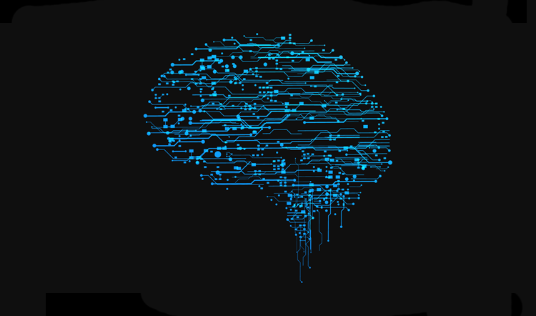
CONTENTS
1- Abstract
2- Introduction
3- Motivation and
Objective of the project
4- Flow process
5- Experimental Results
6- Conclusion

Slide 3
ABSTRACT
The Rapid growth of new documents and multimedia news has created new challenges in pattern recognition and machine learning the problem of handwritten digit recognition has long been an open problem in the field of pattern classification.
Handwriting recognition is one of the compelling research works going on because every individual in this world has their own style of writing. It is the capability of the computer to identify and understand handwritten digits or characters automatically.
main objective of this project is to provide efficient and reliable techniques for recognition of handwritten numeral

Slide 4

INTRODUCTION
ABOUT DATASET-
MNIST dataset has the following features:
Dataset size 70,000 samples of handwritten images.
The size of each image is 28x28 pixels.
Each image has only 1 color channel, i.e., grayscale image.
Each pixel has value in the range of [0,255] where 0 represents black, and 255 represents white.
Each image has labeled from 0-9.

Slide 5
ABOUT THE TECHNOLOGY USED
In machine-learning a convolutional network neural network that is a class of deep feed-forward artificial neural network that has successfully been applied to analyze visible imagery.
CNN uses a variation of multilayer perception design to require minimal preprocessing.
They are also known as a shift-invariant order space invariant artificial neural network, based on their shared weights architecture and translation in violence characteristics.

Slide 6
MOTIVATION & OBJECTIVE OF PROJECT
THIS PROJECT CLEARLY RECOGNISE THE HANDWRITTEN DIGIT IN WHATEVER WAY IT IS WRITTEN.
HERE WE WILL TRY TO ACHIEVE THE BEST POSSIBLE ACCURACY OF OUR MODEL.
THIS PROJECT AIMS TO RECOGNIZE THE HANDWRITTEN DIGIT BY USING A TOOL FROM MACHINE LEARNING TO TRAIN THE CLASSIFIED SO IT PRODUCES PERFORMANCE.

Slide 7
FLOW PROCESS
1- TensorFlow JUYPTER NOTEBOOK IS CREATED
2- LIBRARIES SUCH AS KERAS, MATPLOTLIB, NUMPY IS IMPORTED
3- MNIST DATASET IS DIVIDED INTO 2 PARTS i.e TRAINING & TEST.
4-THE DATA HAVE BEEN CLEANED AND NORMALIZED
5-LAYERS SUCH AS CONV2D, DENSE & FLATTENED IS USED TO ATTAIN
MAXIMUM ACCURACY.

Slide 8
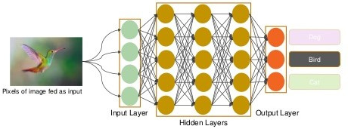
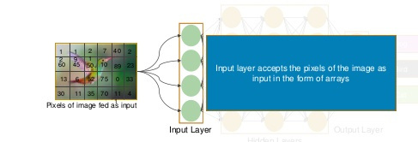

Slide 9
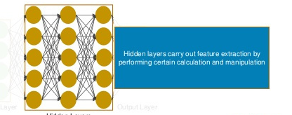
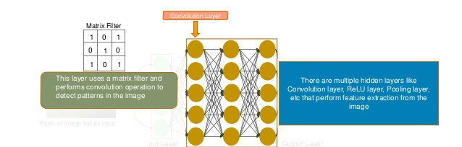

Slide 10
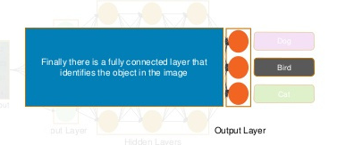

Slide 11
6- THE MODEL IS COMPILED & THE ATTRIBUTES USED WERE -
LOSS, OPTIMIZER
7- AFTER THE COMPILATION THE MODEL IS SET FOR TRAINING
WITH 3 EPOCHES
8- THE ACCURACY GRAPH OF MODEL IS LABELED
9-AFTER THE TRAINING THE PREDICTION PART COMES INTO THE PICTURE
& IT IS DONE BY USING TEST DATASET THAT HAS 10000 ROWS

Slide 12
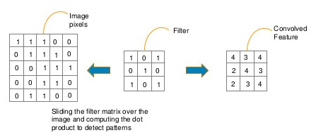
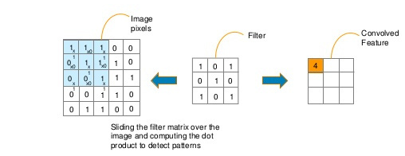
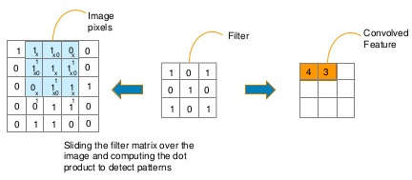
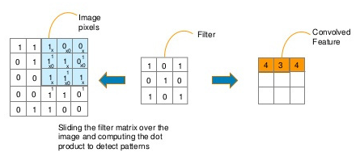
READING AN IMAGE

Slide 13

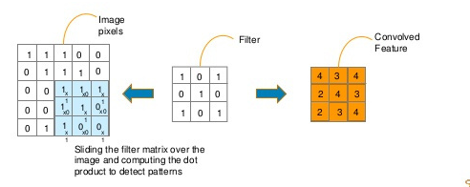

Slide 14
EXPERIMENTAL RESULT
IN TAB 67 ,WE ARE WRITING THE CODE TO PREDICT THE DIGIT WITH THE HELP OF MODEL WE HAVE TRAINED.
WE GOT THE OUTPUT - 7,2,1,0,41,
IN TAB 68 WE ARE TRYING TO CHECK WHERE THE OUTPUT FETCH BY PREDICTION IS SAME AS THE TEST DATA OUTPUT?
YES.....!
IN TAB 70 WE ARE RUNNING A LOOP TO HAVE THE NUMERIC IMAGE OF TEST DATASET AND CROSSCHECK
HENCE WE CAN SEE THAT EVERYTHING IS SAME & WE ARE GETTING THE SAME NUMBERS.

Slide 15
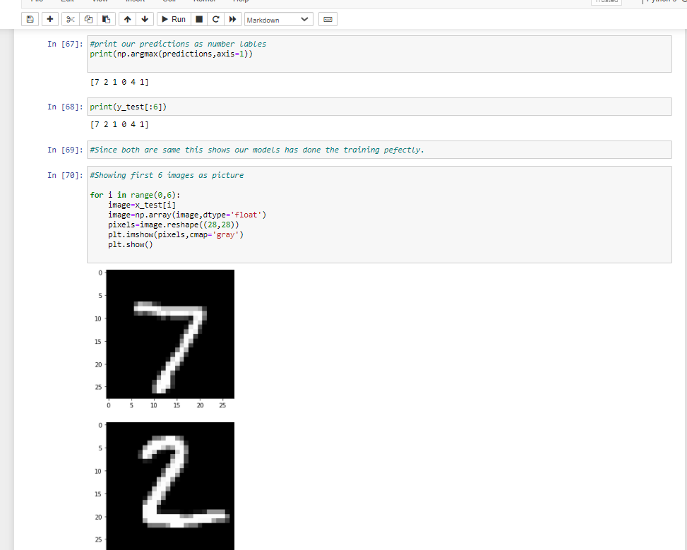
85%
70%
MAKE PURCHASES BASED ON DESIGN
STOP USING APPS WITH POOR UI/UX DESIGN

Slide 16



CONCLUSION
50
40
AT THE END WE CAN CLEARLY RECOGNIZE THE HANDWRITTEN DIGIT BY USING OUR MODEL AND WITH THE ACCURACY OF 98%.
30
20
10
0
Item 1
Item 2
Item 3
Item 4
Item 5

